Slide 1

Gokhale Education Society’s
R. H. Sapat College of Engineering, Management Studies and Research,
Nashik - 422 005, (M.S.), INDIA
Seminar on,
Sentiment Analysis in E-Commerce: Exploring Random Forest and Clustering Ensemble Techniques
In partial fulfillment of requirements for the degree
Third Year Computer Engineering
By
Swayam Pratimkumar Badhe
Exam Seat No. :
Roll No. : 09
Under the guidance of
Dr. Neeta Deshpande

Slide 2
Introduction
Sentiment analysis, also known as opinion mining, is a powerful technique
used to decipher and categorize opinions and emotions expressed in textual
data.
E-commerce platforms thrive on customer feedback and reviews, which
directly influence buying decisions.
Sentiment analysis empowers e-commerce businesses to adapt quickly to
changing market trends and enhance customer experiences.

Slide 3
Literature Survey
Sentiment Analysis Using Random Forest Algorithm - This paper focuses on sentiment analysis in the context of e-commerce, emphasizing the importance of customer feedback and reviews. It introduces feature-based opinion extraction and employs Machine Learning algorithms like Random Forest and Support Vector Machine (SVM) to achieve a remarkable 97% accuracy
Improved Random Forest Classification Approach with Hybrid Clustering - In this paper, the authors propose an enhancement to the Random Forest classification method by ensuring diversity in the model. They introduce cluster integration selection with the Dunn index and address the shortcomings of hierarchical clustering. The approach is applied successfully to classify personal indoor thermal preferences, proving its effectiveness.

Slide 4
Literature Survey
Meta-Analysis of Research in Random Forests for
Classification - This paper conducts a meta-analysis of research papers spanning from 2001 to 2015 that introduce novel Random Forest (RF) algorithms and compare them to established RF methods. The analysis reveals limitations in performance measures, estimation methods, and comparative methodologies

Slide 5
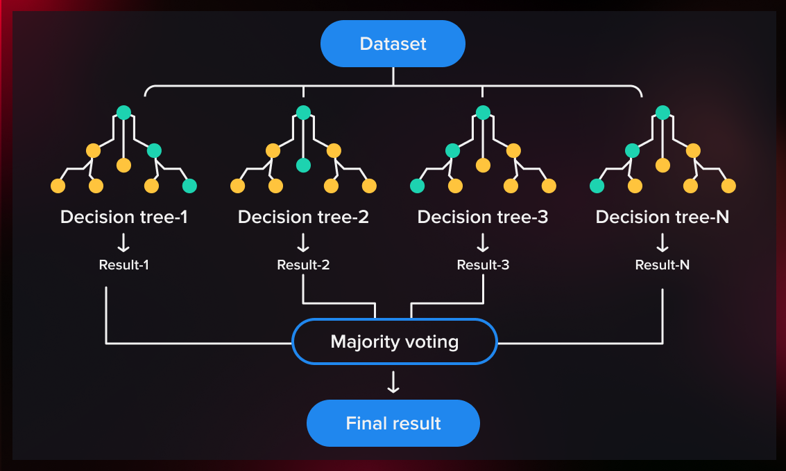
Details of technology
Random Forest Algorithm in Sentiment Analysis –
1. Random Forest is an ensemble learning method used for classification and regression tasks.
2. Random Forest employs decision trees as its base classifiers.
3. Each tree contributes to the final prediction through a process known as majority voting or averaging.
Strengths - Handling Complexity
Feature Processing
Diverse Patterns
Limitations - Not Suitable for All Data
Parameter Tuning

Slide 6

Topic / Technology Necessity
1. Understanding Customer Sentiments
a. Customer Insights
b. Competitive Edge
2. Crucial for E-Commerce
a. E-Commerce Landscape
b. Product Reviews
3. Challenges in Sentiment Categorization
a. Mixed Reviews
b. Specific Features
Why Random Forest –
Random Forest excels in handling the complexity of textual data generated by customer reviews.
Its ensemble nature allows it to capture diverse sentiment patterns effectively.

Slide 7
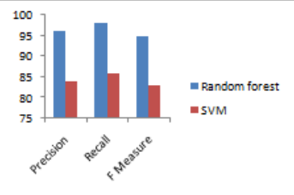
Experimental work
Experimental Setup -
1. Dataset: Utilized product reviews from Flipkart, a prominent online shopping platform.
2. Objective: Classify product ratings into positive, neutral, and negative sentiments.
3. Analysis: Applied sentiment analysis techniques to uncover customer opinions.

Slide 8
Experimental work
Methodology –
1. Random Forest Algorithm -
a. Data Pre-processing - The Flipkart product reviews dataset was preprocessed to extract relevant features, including keywords, sentiment lexicons, and n-grams
b. Ensemble learning - It constructed multiple decision trees during training, each of which learned distinct patterns from the reviews
c. Sentiment Classification - It effectively categorized product ratings into positive, neutral, and negative sentiments based on the extracted features

Slide 9
Experimental work
2. Clustering Ensemble Selection –
a. Enhancing Sentiment Clustering - Multiple clustering algorithms were combined to improve sentiment clustering quality.
b. Adapting to Data Characteristics - Tailored clustering ensemble methods for Flipkart reviews to enhance sentiment precision. Employed techniques like hierarchical clustering and the Dunn index for optimal cluster selection.
c. Nuanced Understanding: Utilized hierarchical clustering to categorize reviews into multi-level sentiment groups, providing a detailed sentiment analysis.

Slide 10
Applications
Applications of Random Forest -
1. Enhancing Customer Experience
2. Product Development – identify product features that require enhancement
3. Product Recommendations - analyze user preferences and provide
personalized product recommendations
Applications of Sentiment Analysis -
1. Customer Reviews - analyze and categorize customer reviews
2. Social Media Monitoring - track public sentiment on social media platforms
3. Political Analysis - assess public sentiment toward candidates and issues
4. Healthcare - used to monitor patient sentiment during clinical trials

Slide 11
Discussion and Conclusion
Random Forest – Achieved robust performance with high accuracy in
categorizing data
Techniques like hierarchical clustering and the Dune index enhanced
sentiment clustering precision
In conclusion -
Random Forest emerged as a strong choice for sentiment analysis,
particularly in the context of e-commerce and the unique Flipkart dataset.

Slide 12
References
1. P. Karthika, R. Murugeswari and R. Manoranjithem, "Sentiment Analysis of Social Media Network Using Random Forest Algorithm," 2019 IEEE International Conference on Intelligent Techniques in Control, Optimization and Signal Processing (INCOS), Tamilnadu, India, 2019, pp. 1-5, doi: 10.1109/INCOS45849.2019.8951367.
2. D. Yuan, J. Huang, X. Yang, and J. Cui, "Improved random forest classification approach based on hybrid clustering selection," 2020 Chinese Automation Congress (CAC), Shanghai, China, 2020, pp. 1559-1563, doi: 10.1109/CAC51589.2020.9326711.
3. A. Pretorius, S. Bierman, and S. J. Steel, "A meta-analysis of research in random forests for classification," 2016 Pattern Recognition Association of South Africa and Robotics and Mechatronics International Conference (PRASA-RobMech), Stellenbosch, South Africa, 2016, pp. 1-6, doi: 10.1109/RoboMech.2016.7813171.

